Slide 1

Communications Compliance
2025 Operational Overview

Slide 2
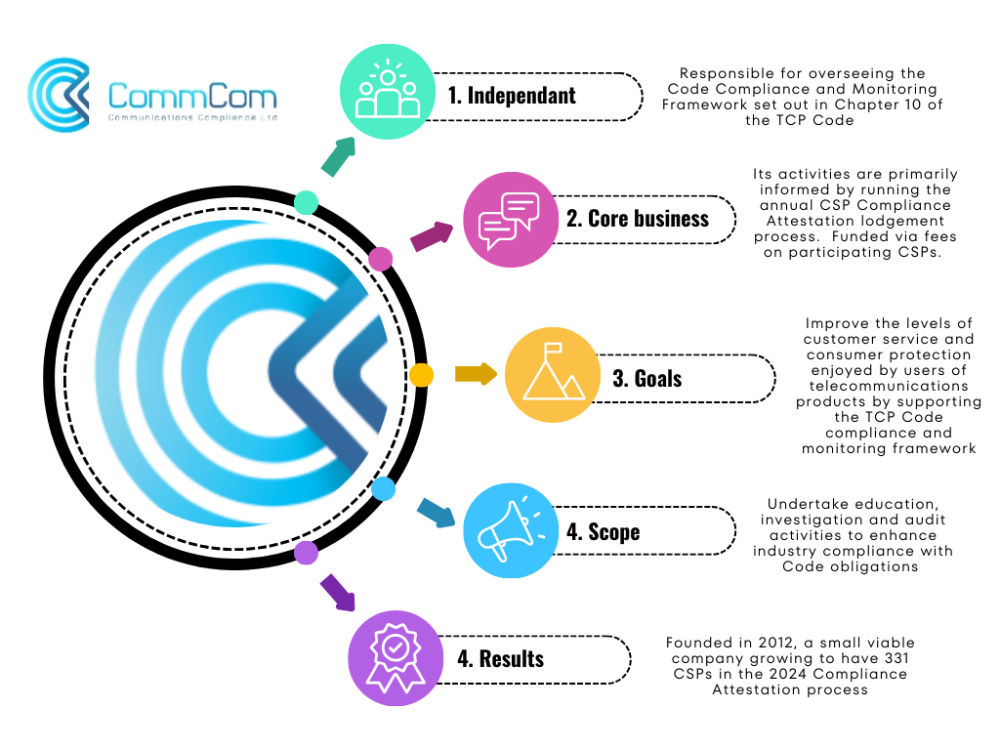

Slide 3
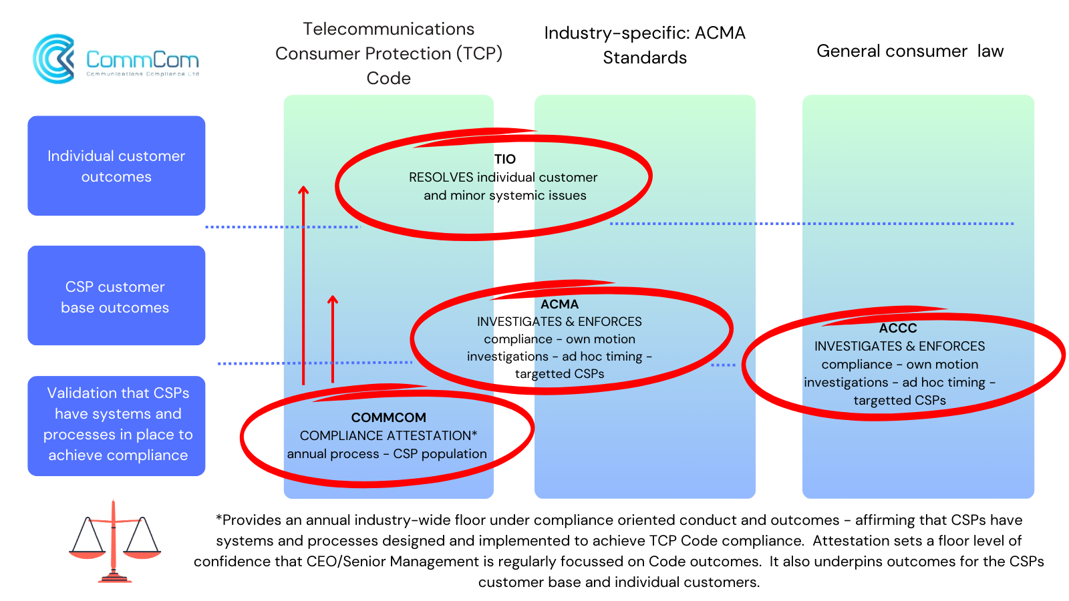

Slide 4
Annual Provider Compliance Attestation Process
1
Compliance Attestation. 40-50 questions focussing on key Code obligations. Attestation developed in consultation with key stakeholders (Industry, ACCAN, ACMA). Varies year on year to focus on key compliance priorities.
2
Attestation Lodgement. Facilitated via CommCom CSP Portal. Lodgement window typically runs June-September.
3
Assessment and Feedback: Each attestation individually assessed, with answers being verified against available customer facing collateral (websites, staff training manuals, other requested material). Feedback and directions to remedy fed back to providers for actioning within a specified timeframe.

Slide 5
Annual Provider Compliance Attestation Process
4
Referral for non-compliance (Chapter 10). Referral to the ACMA where remedial action has not been completed. Failure to lodge an Attestation , if bound by Code, also referred to the ACMA.
5
Publication. Names of providers who have fulfilled the requirement to lodge an annual attestation published on CommCom’s website. On average 320-340 individual provider lodgements received annually.
6
Role of Wholesale providers: Not directly bound by the Code. Ensure that downstream resellers in the consumer space are aware of their obligations under the Code in general, including the annual Attestation process.

Slide 6

www.commcom.com.au
info@commcom.com.au

